Slide 1
Contents
IP Forwarding
Packet Fragmentation
Error Handling with ICMP
IP Version 6
Network Address Translation

Slide 2
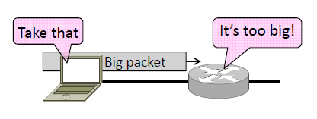

Packet Fragmentation
How do we connect networks with different maximum packet sizes?
– Need to split up packets, or discover the largest size to use

Slide 3
Packet Size Problem
Different networks have different maximum packet sizes
– Or MTU (Maximum Transmission Unit)
– E.g., Ethernet 1.5K, WiFi 2.3K
Prefer large packets for efficiency
– But what size is too large?
– Difficult because node does not know complete network path

Slide 4
Packet Size Solutions
Fragmentation
– Split up large packets in the network if they are too big to send
– Classic method, dated
Discovery
– Find the largest packet that fits on the network path and use it
– IP uses today instead of fragmentation

Slide 5
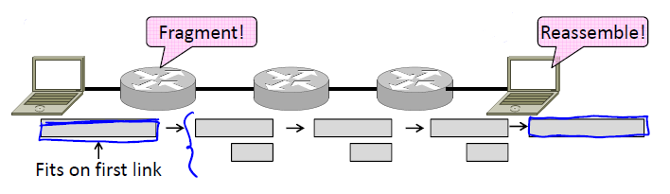
IPv4 Fragmentation
Routers fragment packets that are too large to forward
Receiving host reassembles to reduce load on routers

Slide 6
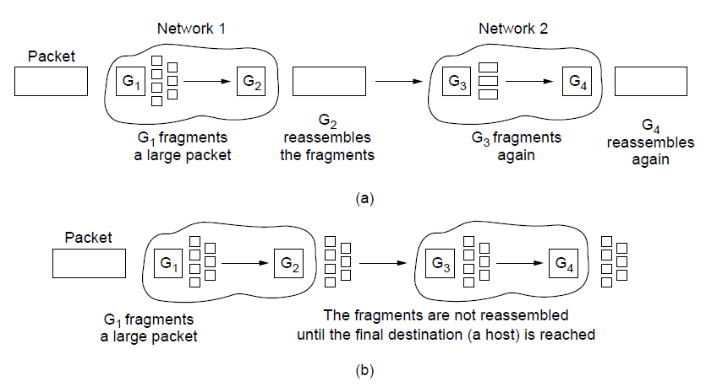
IPv4 Fragmentation
Networks have different packet size limits for many reasons
Large packets sent with fragmentation & reassembly
Transparent – packets fragmented / reassembled in each network
Non-transparent – fragments are reassembled at destination

Slide 7
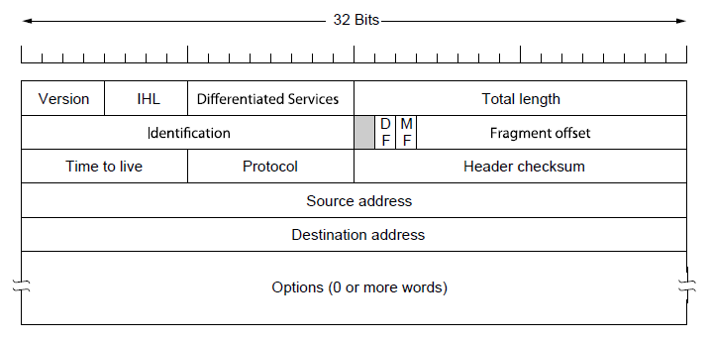
IPv4 Fragmentation
Header fields used to handle packet size differences
– Identification, Fragment offset, MF/DF control bits

Slide 8
IPv4 Fragmentation Procedure
Routers split a packet that is too large:
– Typically break into large pieces
– Copy IP header to pieces
– Adjust length on pieces
– Set offset to indicate position
– Set MF (More Fragments) on all pieces except last
Receiving hosts reassembles the pieces:
– Identification field links pieces together, MF tells receiver when it has all pieces

Slide 9
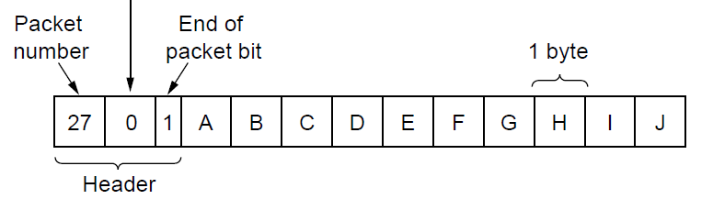
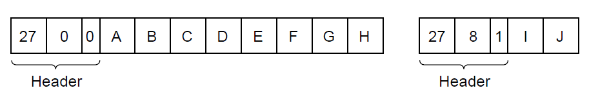
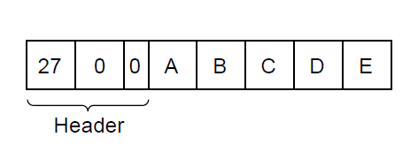
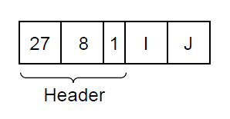
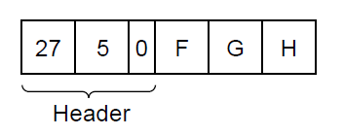
IPv4 Fragmentation
Example of IP-style fragmentation:
Start
offset
Packet
number
End bit
Original packet:
(10 data bytes)
Fragmented:
(to 8 data bytes)
Re-fragmented:
(to 5 bytes)

Slide 10
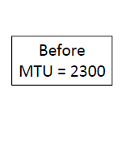
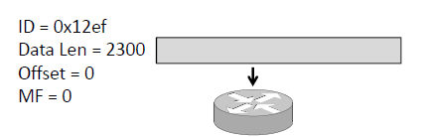
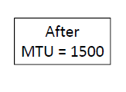
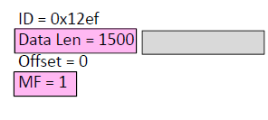
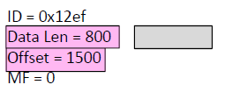
IPv4 Fragmentation

Slide 11
IPv4 Fragmentation
It works!
– Allows repeated fragmentation
But fragmentation is undesirable
– More work for routers, hosts
– Tends to magnify loss rate
– Security vulnerabilities too

Slide 12
Path MTU Discovery
Discover the MTU that will fit
– So we can avoid fragmentation
– The method in use today
Host tests path with large packet
– Routers provide feedback if too large; they tell host what size would have fit

Slide 13
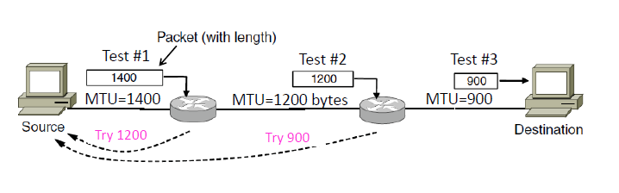
Path MTU Discovery

Slide 14
Path MTU Discovery
Process may seem involved
– But usually quick to find right size
Path MTU depends on the path and so can change over time
– Search is ongoing
Implemented with ICMP (next)
– Set DF (Don’t Fragment) bit in IP header to get feedback messages

Slide 15
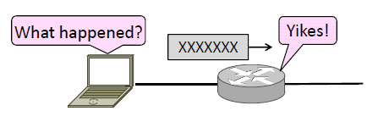
Error Handling
What happens when something goes wrong during forwarding?
– Need to be able to find the problem

Slide 16
Internet Control Protocols
IP works with the help of several control protocols:
ICMP is a companion to IP that returns error info
Required, and used in many ways, e.g., for traceroute
ARP (Link Layer) finds Ethernet address of a local IP address
Glue that is needed to send any IP packets
Host queries an address and the owner replies
DHCP (Application Layer) assigns a local IP address to a host
Gets host started by automatically configuring it
Host sends request to server, which grants a lease

Slide 17
Internet Control Message Protocol
ICMP is a companion protocol to IP
– They are implemented together
– Sits on top of IP (IP Protocol=1)
Provides error report and testing
– Error is at router while forwarding
– Also testing that hosts can use

Slide 18
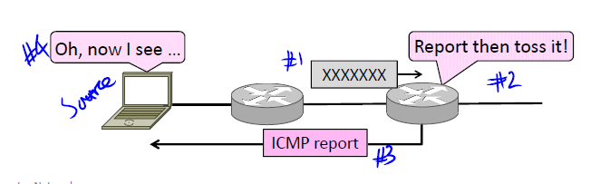
ICMP Errors
When router encounters an error while forwarding:
– It sends an ICMP error report back to the IP source address
– It discards the problematic packet; host needs to rectify

Slide 19
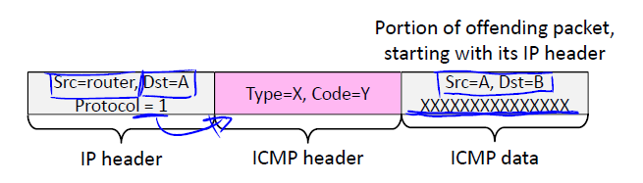
ICMP Errors
Each ICMP message has a Type, Code, and Checksum
Often carry the start of the offending packet as payload
Each message is carried in an IP packet

Slide 20
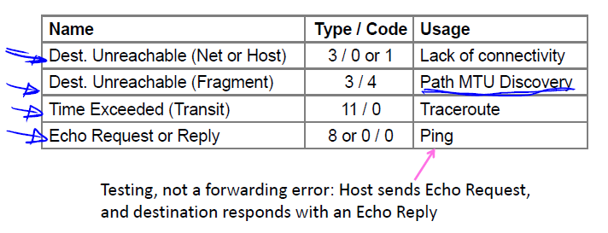
ICMP Errors

Slide 21
Traceroute
IP header contains TTL (Time to live) field
Decremented every router hop, with ICMP error if it hits zero
Protects against forwarding loops

Slide 22
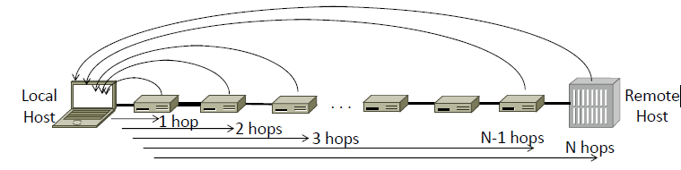
Traceroute
Traceroute repurposes TTL and ICMP functionality
– Sends probe packets increasing TTL starting from 1
– ICMP errors identify routers on the path

Slide 23
IP Version 6
Major upgrade in the 1990s due to impending address exhaustion, with various other goals:
Support billions of hosts
Reduce routing table size
Simplify protocol
Better security
Attention to type of service
Aid multicasting
Roaming host without changing address
Allow future protocol evolution
Permit coexistence of old, new protocols, …
Deployment has been slow & painful, but may pick up pace now that addresses are all but exhausted

Slide 24
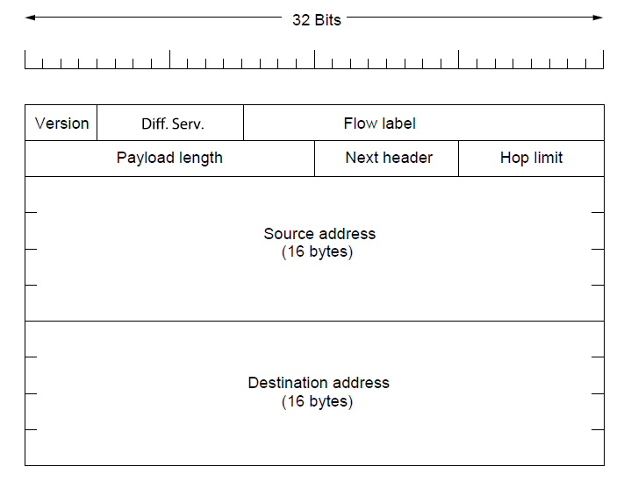
IP Version 6
IPv6 protocol header has much longer addresses (128 vs. 32 bits) and is simpler (by using extension headers)

Slide 25
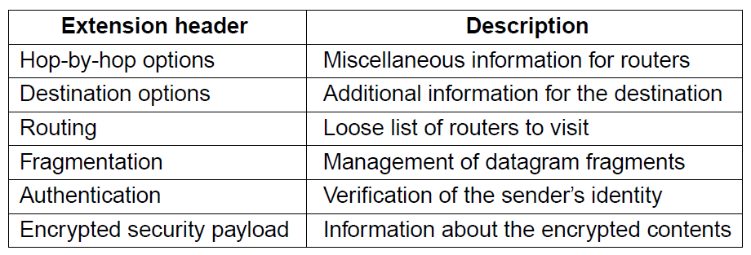
IP Version 6
IPv6 extension headers handles other functionality

Slide 26
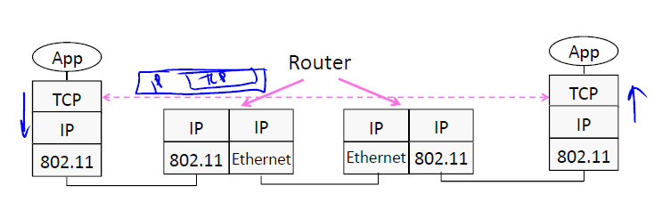
Layering Review
Remember how layering is meant to work?
– “Routers don’t look beyond the IP header.” Well …

Slide 27
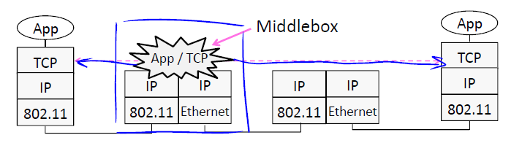
Middleboxes
Sit “inside the network” but perform “more than IP” processing on packets to add new functionality
– NAT box, Firewall / Intrusion Detection System

Slide 28
Middleboxes
Advantages
A possible rapid deployment path when there is no other option
Control over many hosts (IT)
Disadvantages
Breaking layering interferes with connectivity; strange side effects
Poor vantage point for many tasks

Slide 29
Middleboxes
NAT box connects an internal network to an external network
– Many internal hosts are connected using few external addresses
– Middlebox that “translates addresses”
Motivated by IP address scarcity
– Controversial at first, now accepted

